Slide 1
FBG WORKING PRPCESS

Slide 2
Fig. FBG based liquid level measurement set-up

Slide 3
Fig. Typical FBG principle as a wavelength selector

Slide 4
Fig. Wavelength vs transmission of light from FBG water level sensor. Shift in a Bragg wavelength for different liquid levels

Slide 5
Shift in Bragg wavelength with respect to temperature. FBG temperature sensor

Slide 6
FBG as chemical sensor

Slide 7
FBG for Elemental analysis (Cl and Fe detection)
Fig. FBG wavelength shift with respect to Cl concentration (FBG for Cl detection)

Slide 8
Fig. FBG wavelength shift with respect to Fe concentration (FBG for Fe detection)

Slide 9
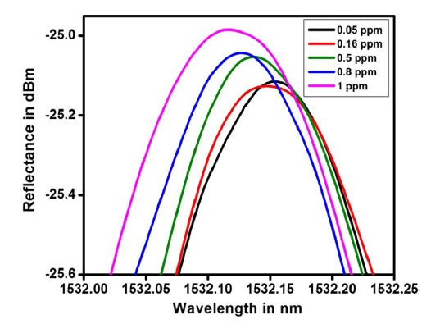
Fig. FBG wavelength shift with respect to Lead (Pb) concentration (FBG for Pb detection)

Slide 10
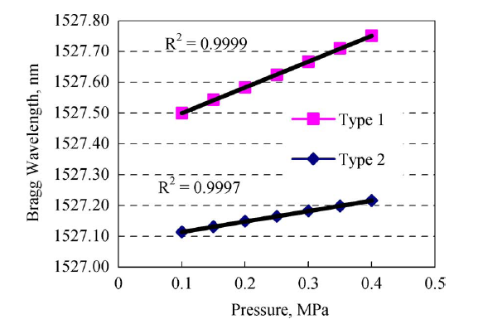
Fig. Pressure vs Bragg wavelength shift (FBG as a pressure sensor)

Slide 11
Fig. Strain vs Bragg wavelength shift (FBG as a Strain sensor)

Slide 12
Fig. Force vs Bragg wavelength shift (FBG as a Force sensor)

